Slide 1
Advancing Nanobiotechnology
Commercialization
ISPE Carolina-South Atlantic Chapter
Fourth Annual Fall Gala
September 30, 2010
Brooks Adams
Executive Director & President

Slide 2
Advancing Nanobiotech Commercialization
The nanobiotech opportunity
Market overview
Future
Nanobiotech in NC
COIN
Summary

Slide 3
Nanobiotechnology
Application of nanotechnology materials, tools,
& processes in the life sciences & medicine
Commercial applications:
Therapeutics & diagnostics
Medical technology & devices
Medical/life science research
Non human health-care related
Cardiac progenitor cell cultures on PCL nanofibers., Duke University, Nicolas Christoforu & Kam Leong

Slide 4
The opportunity
“Human health has always been determined on the
nanometer scale…where the structure & properties of
the machines of life work in every one of the cells in
every living thing. The practical impact of
nanosciences on human health will be huge.”
Dr. Richard Smalley, Nobel Laureate, 1943-2005

Slide 5
Nanomaterials & medical applications
Source: BCC research

Slide 6
Nanotech/nanobiotech represents a tool box
Many potential high value applications, for example, using nanotech approaches can help address number of issues in drug development:
Incorporation of difficult to solubilize API
Improving API stability
Controlling bioavailability
Controlled uniformity
Controlling drug/excipent interaction
Targeted delivery
Not an industry!
Often represents platform technology Plays into pharma, biotech, and medtech value chains

Slide 7
The promise & challenge
Nanotech centers are forming globally
Industry clusters growing around them
Requisite capabilities/resources:
Research
Money
Infrastructure
Conducive business environment
Talent
Only a few major centers will develop
“A Roadmap for Nanotechnology in NC’s 21st Century Economy,” March 2006

Slide 8
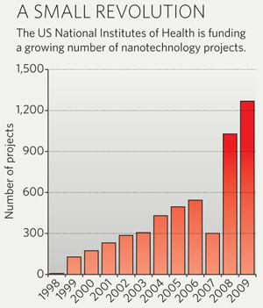
Significant federal funding, e.g. NIH

Slide 9
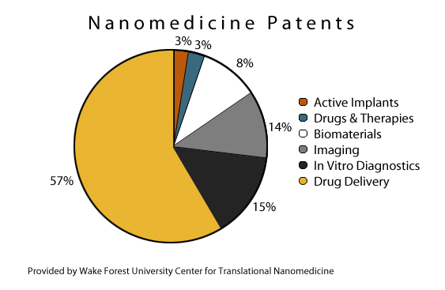
Nanomedicine patents
.

Slide 10
Nanobio global market
2009 nanomedicine healthcare markets:
N America $4.75 billion
Europe $3.65 billion
280 US nanobio companies
150 international nanobio companies
US hubs: Boston, San Francisco, Houston, & RTP
US academic centers: NC, MA, CA, OH, & TX
Sources: Business Insights (Jan 2010), Pew Charitable Trusts, COIN database

Slide 11
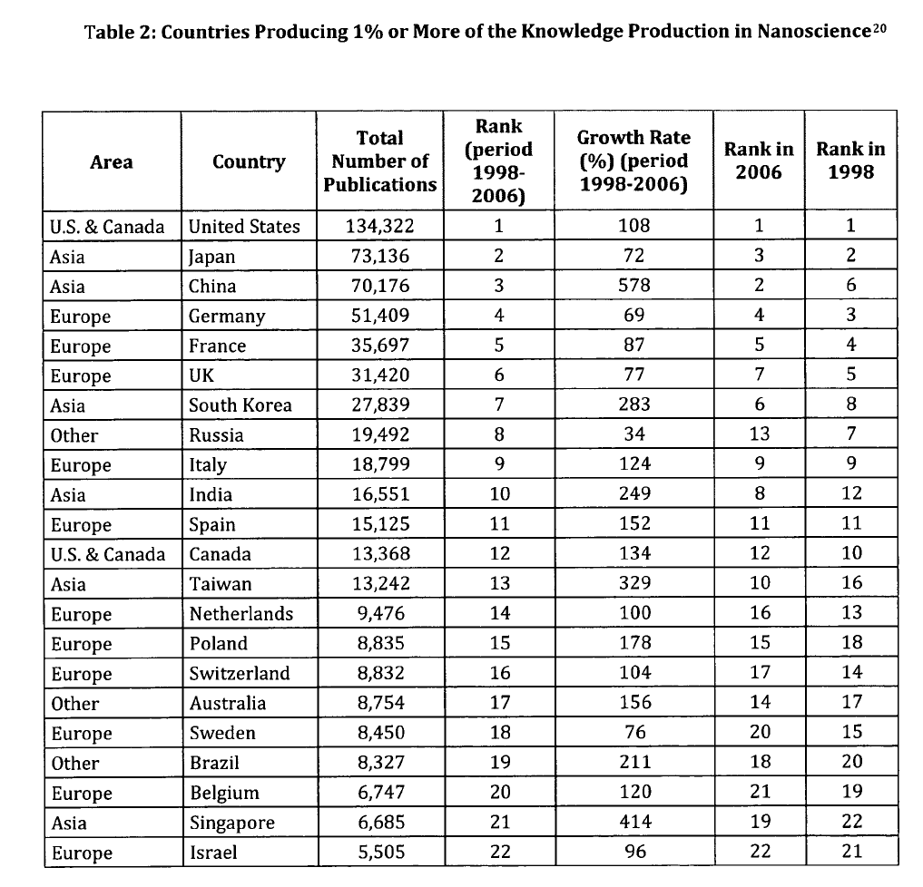
Countries Contributing 1% or More of Knowledge-Production in Nanoscience
Delemarle, 2009 Nanotech. L. & Bus. 103 2009

Slide 12
Top 15 global therapeutic classes 2009
CLASS 2009 SALES (BILLIONS) ANNUAL GROWTH
Oncologics $52.37 8.80%
Lipid Regulators $35.28 4.90%
Respiratory Agents $33.59 11.00%
Antidiabetics $30.40 13.40%
Anti-ulcerants $29.61 0.60%
Angiotensin II Antagonists $25.20 11.40%
Antipsychotics $23.24 4.60%
Antidepressants $19.41 -1.30%
Autoimmune Agents $17.96 18.00%
Platelet Aggr. Inhibitors $14.60 9.00%
HIV Antivirals $13.75 14.90%
Anti-epileptics $12.99 -19.80%
Narcotic analgesics $11.23 8.60%
Non-narcotic analgesics $11.17 7.30%
Erthropoietins $10.80 -4.10%
Source: IMS Health

Slide 13
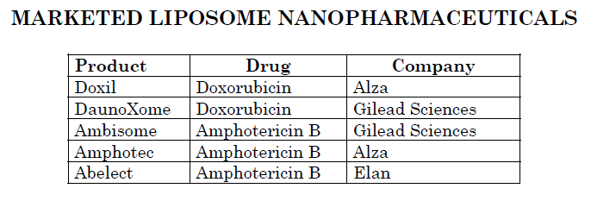
Nanoenabled products on market or coming soon
Many
Many dendrimer & micelle-based products in development
Source: Livingston Group

Slide 14
Advancing Nanobiotech Commercialization
The nanobiotech opportunity
Market overview
Future
Nanobiotech in NC
COIN
Summary

Slide 15
The future of nanomedicine
The Livingston Group perspective is:
Expansion beyond oncology into ophthalmic, women’s health, infectious diseases, and CNS
Diagnostics flood gate leaking but not open yet
Regenerative medicine regulatory views and early technical successes are encouraging
A bit more intelligence in smart therapeutics (nanodevices)

Slide 16
Nano-enabled targeted delivery
Untargeted delivery
Targeted delivery
Actives affect unintended tissues
Side effects mitigated or eliminated
Lower cost for smaller amount of active molecule and targeting system
High cost for large amount of active molecule
◎
◎
Too little of the needed dose reaches the target
The right therapeutic dose reaches the target
Actives degraded or excreted before reaching target
Less active released into the environment
Active ingredient
Nano-enabled targeting system
Source: Lux Research
Source: Lux Research
Notes:
Example: paclitaxel – not the active itself but the solvents administered with it that cause painful side effects in patients

Slide 17
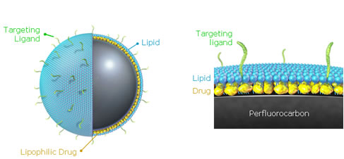
What technology enables control of delivery?
Nanoparticulate reformulations/ depot systems
Nano-encapsulation
Bio/chemical targeting
Advanced materials
Drug-device combinations
Source: Lux Research

Slide 18
Site-specific, targeted delivery + imaging
Nanotherapeutics Initiative, Kam Leong, Duke University

Slide 19
Development hurdles
Formulations likely need to be tailored for each new product, lengthening development cycles

Slide 20
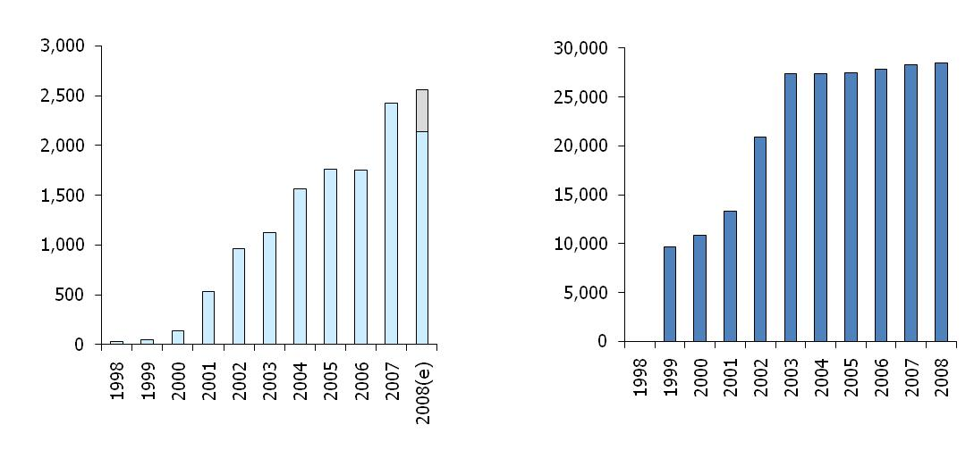
Strong scientific publishing/patenting activity
Nano-enabled targeted delivery
Number of published journal articles
Number of issued patents and patent applications
Source: Lux Research

Slide 21
Targeted nano-enabled delivery market to boom
2010 market size: $6.8 B
2015 market size: $21.1 B
Other applications for nano-enabled delivery include cosmeceuticals, nutraceuticals, agriculture, and food
Drug delivery claims 97% of the total targeted delivery market today; 90% by 2015
Source: Lux Research

Slide 22
Space highly fragmented
Companies with highest number of targeted delivery patents
Breakdown of targeted delivery developers by type and by 2008 revenue
100+ others
153 Public companies
>$1B 23
$500M-1B 9
$100M-500M 18
$50M-100M 14
<$50M 89
220 Private companies
Source: Lux Research
Notes:
High fragmentation is an indication of an emerging industry – despite the fact that this technology has (more or less) been around since 1980s. Innovation is still happening, but there has been little vertical integration

Slide 23
Tissue engineering constructs that control cell response
Nanotherapeutics Initiative, Kam Leong, Duke University

Slide 24
Nano-enabled TERM
Technologies:
- Tissue regeneration scaffolds - Structural implant materials
- Bone repair - Bioresorbable materials
- Some implantable devices - Surgical aids
- Operating tools - Smart instruments
Market drivers:
“Smart biomaterials” currently $47B opportunity
Spinal repair, active wound care, bone fillers, & orthopedic biomaterials
Only to increase with aging baby-boom generation
Hurdles:
Several applications (especially spine-related injury) very early stage
Innovation around implantable devices is incremental, rarely disruptive
Source: Lux Research

Slide 25
Nanobio a burgeoning field with challenges
Shortage of qualified personnel
Education of workforce for future
Limited funding for early-stage innovation
Need for:
Low-cost, flexible research space
Multidisciplinary research partnerships
Business development connections
Pre-clinical/clinical testing guidance & facilities
GMP capability/manufacturing scale up

Slide 26
Manufacturing advanced nanomedical products
Innovations required at this time
Large players may have capabilities in house
Small, emerging companies may struggle
Few third party contractors ready
Numerous issues:
Cost
Reliability/robustness
EH&S
Supply chain
Patents/knowhow
Defined procedures for FDA submission

Slide 27
Services needed by emerging companies
Clinical and regulatory strategy & guidance
Formulation
Analytics/bioanalytics
Physical characterization
Clinical manufacturing
ICH stability
In-vitro release testing

Slide 28
Advancing Nanobiotech Commercialization
The nanobiotech opportunity
Market overview
Future
Nanobiotech in NC
COIN
Summary

Slide 29
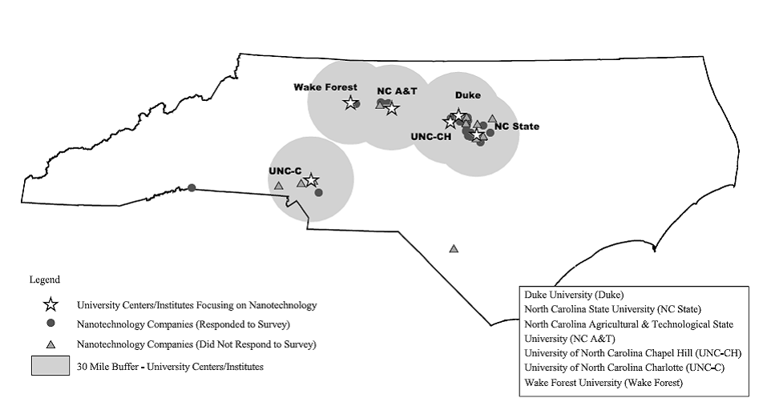
Vision for NC
Assets to succeed lie in Charlotte, Piedmont Triad, & Triangle
Mix of nanotech research activity, medical centers, related large/emerging companies, & investors
To be nationally competitive, imperative to leverage resident assets & collaborate

Slide 30
NC nanobiotech ecosystem
Building from thriving NC biotech industry/infrastructure, emerging nanobio sector gaining rapid traction
NC strong in 3 of highest growth nanotech sectors:
Medicine & healthcare
Tools/instruments
Materials
NC repeatedly recognized as nanotech leader:
2009 PEN survey ranked:
NC 8th in US
Raleigh metro 4th in US
2009 US University Report & Rankings by Small Times placed:
NCSU 3rd for nanotech commercialization & UNC-CH 5th
NCSU 10th for nanotech research
Positive political-business climate in support of biotech
NC Innovation Council
Low-cost of doing business, & high quality of life

Slide 31
NC nanobiotech ecosystem
Industry
> 35 nanobio & 70 nanotech cos
>528 bioscience companies
~400 medtech companies
University/academic
35 university research centers
WFIRM
2 nanotech Ph.D. programs
Among 1st with nanotech A.S.
3 major nonprofit research institutes with nanotech interests
Medical centers
4 medical schools & 5 major teaching hospitals
Medical school forming in Charlotte
Supportive infrastructure
108 medical products CRO’s
7 major research parks across NC
Active, engaged VCs & angels
NC Department of Commerce
NCBC & Centers of Innovation:
NC Regional Partnerships
Entrepreneur resources
CED, BIG, BREC, other
SBTDC
Southeast TechInventures (STI)
First Flight & univ-based incubators

Slide 32
NC resources for translation
Synthesis
Characterization
WFU Nanotech Center, JSNN, Forsyth Tech, Murdoch
Clinical Trials
Duke, UNC, WFU , and ECU med schools
RTI, CROs
Nanotech Labs; Blue Nano
WFU Nanotech Center
In Vitro
In Vivo
Murdoch, Biomedical Innovation Network, JSNN, UNC, RTI
Murdoch, Biomedical Innovation Network, JSNN, ECU, RTI

Slide 33
RTI nanomaterials registry
$2.9 million funding from NIH to establish web-based registry
Provide curated information on biological & environmental interactions of well-characterized nanomaterials
Facilitate data validation and data quality improvement of nanomaterials; enhance the development of new models, assays, standards, and manufacturing methods; and accelerate the translation of new nanomaterials for biomedical and environmental applications.
To allow for the integration of diverse data sources in this field and engage scientists in nanomaterials community to promote common nanomaterials standards
Will identify reliable information that can be used in regulatory decision making
To collaborate with industry groups, standards organizations and government agencies to develop/validate registry

Slide 34
NC/SE nano drug delivery university leaders
University Texas
Harvard University
MIT
University of Michigan
Johns Hopkins University
University of Illinois
Northwestern University
University of Washington
Purdue University
University of Utah
Georgia Institute of Technology
Washington University
University of Florida
University Pennsylvania
Cornell University
University of California at Berkeley
University of Massachusetts
University of California at San Francisco
University of Minnesota
NCI
Rice University
Ohio State University
University of California at Los Angeles
University of California at Santa Barbara
University Nebraska
University of North Carolina
University of Wisconsin
Penn State University
Massachusetts General Hospital
University of Kentucky
Stanford University
University of Maryland
University of Southern California
University of Pittsburgh
University of California at Davis
Emory University
SUNY Buffalo
University of California at San Diego
Northeastern University
Carnegie Mellon University
North Carolina State University
Vanderbilt University
Case Western Reserve University
Duke University
Brown University
CALTECH
Arizona State University
Columbia University
Rutgers State University
University of Delaware
Source: COIN study (based on publications)

Slide 35
NC nanobio companies
Drug Discovery and Delivery
Asklepios Biopharma Chapel Hill
BioDelivery Sciences Raleigh
Branthan Laboratories Greensboro
Cromoz Research Triangle Park
Helia Medical Raleigh
Liquidia Durham
Micell Technologies Raleigh
NanIO Biosciences Research Triangle Park
NanoCor Therapeutics Chapel Hill
NanoMed Corp Greensboro
NanoVector Raleigh
Peptagen Raleigh
PharmAgra Laboratories Brevard
Qualiber Chapel Hill
Salzburg Therapeutics Winston Salem
Thermiacure Greensboro
Advanced Medical Technology
Advanced Liquid Logic Morrisville
Biomedomics Durham
Centice Morrisville
Dental Safe Greensboro
Expression Analysis Durham
Filtara Cary
Inanovate Research Triangle Park
Laam Science Morrisville
NanoArt Durham
Novan Research Triangle Park
Nanomics Biosciences Cary
Pioneer Surgical Orthobio/Greenville
Optotrack Cary
QuarTek International Greensboro
XinRay Systems Research Triangle Park
Xintek Research Triangle Park
Other
Blue Nano Cornelius
NanoTech Labs Yadkinville
Specialty Scientific High Point
Xanofi Raleigh

Slide 36
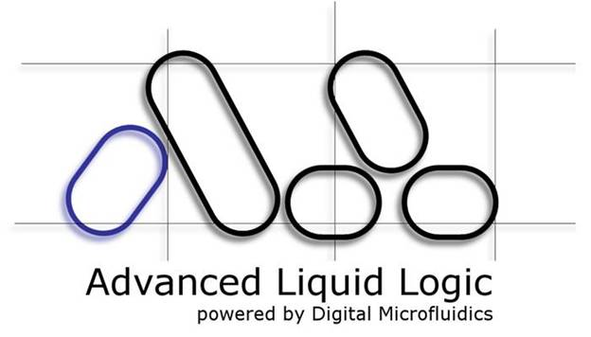
Advanced Liquid Logic
Advanced Liquid Logic is pursuing a better way to do
microfluidics using “Digital Microfluidics” based on
electrowetting technology.
Founded 2004
Located in Morrisville
www.liquid-logic.com

Slide 37
Liquidia Technologies
Liquidia Technologies is developing highly precise particle-
based vaccines and therapeutics for the prevention and
treatment of human disease.
Combining a deep understanding of particle-based drug
development with breakthrough small molecule and biological
therapeutics, Liquidia is engineering vaccines and therapies that
have the potential to dramatically improve the quality of human
life.
Founded 2004
Located in Durham
www.liquidia.com

Slide 38
Pioneer Surgical Orthobiologics
Pioneer Surgical Orthobiologics is a privately-held
R&D company with several biologics technologies on
the market, including a nanobiotechnology-based
bone growth stimulator for orthopedic applications
Founded 1992
Located in Greenville
www.pioneersurgical.com

Slide 39
Xanofi
Xanofi is introducing a new, highly efficient method for
making nanofibers with a wet-spinning technique
called Shear Multiplying™.
The Xanofi process produces high yields at low cost
and features the ability to integrate additives to
create functional, unique fibers.
Founded 2010
Located in Raleigh

Slide 40
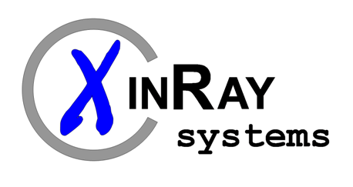
XinRay
XinRay develops and manufactures distributed x-ray
sources for a broad range of applications including
diagnostic medical imaging, homeland security, and
industrial inspection.
Founded 2007
Located in RTP
www.xinraysystems.com

Slide 41
Advancing Nanobiotech Commercialization
The nanobiotech opportunity
Market overview
Future
Nanobiotech in NC
COIN
Summary

Slide 42
COIN key facts
Nonprofit 501c3 launched June 2009
$2.6 million funds committed
4 full-time staff
Outsource finance, marketing, & IT
University intern program (4 - 5)
8 Board members & 7 on Scientific Advisory Board
Annual operating budget $800K
While based in Triangle, frequently in the Piedmont Triad, Charlotte, and beyond

Slide 43
COIN’s mission
Leverage and connect ideas, people, & resources in public
and private sectors to:
Accelerate commercialization of nanobiotechnology that meets needs in medical product & life science sectors and benefits mankind
Promote creation of related R&D collaborations, companies, infrastructure, & new products
Notes:
By doing these things we will boost economic growth in NC & US

Slide 44
COIN programs
Events & seminars:
To build, connect, & inform the community
Nanobiotech Executive Roundtable
Annual NC Nanotech Commercialization Conference
Nanobio track
Membership services:
Including knowledge-rich web portal
Business intelligence
RFP scouting service
Innovation services:
That address specific obstacles to commercialization
Grant writing
Incubation partners
Connections for pre-clinical testing

Slide 45
COIN clients & collaborators
University researchers & tech transfer offices
Pharma/biotech, specialty pharma, drug delivery companies
Startups
VC, angel, & public funding sources
Equipment & software companies
National nanobiotech research institutes
Trade groups
Law & accounting firms
Economic development & policy makers

Slide 46
Advancing Nanobiotech Commercialization
The nanobiotech opportunity
Market overview
Future
Nanobiotech in NC
COIN
Summary

Slide 47
Summary
Nanobio/nanomedicine market is booming but not without challenges in particular for emerging companies
Nano-enabled drug delivery very promising
Guidance needed on clinical requirements
Manufacturing will be a hurdle
Some fields like tissue engineering still early stage
NC will play in major leagues
Many NC emerging nanobio companies offer promise
COIN will coalesce the community/focus on key issues

Slide 48
Brooks Adams, Executive Director & President
8801 Fast Park Drive, Ste 213
Raleigh, NC 27617
Office: (919) 782.1991, ext 300
Cell: (804) 363.9574
brooks.adams@nc-coin.org
www.nc-coin.org
www.linkedin.com/companies/
coin-center-of-innovation-for-nanobiotechnology
@NCNanoBioTech

Slide 49
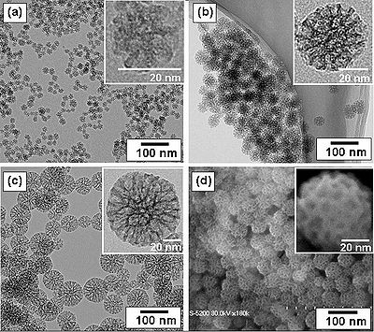
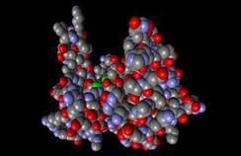
Nanomaterials Fabrication Methods
Gaseous Phase Methods
Chemical Vapor Deposition
Molecular Beam Epitaxy
Atomic Layer Deposition
Liquid Phase Fabrication Methods
Molecular Self Assembly
Sol-gel process
Electro Deposition
Biological Methods
Electro deposition and Nanobiosystems

